Slide 1

Direct Development
Consulting 360 Project
GWU Consulting Team
Tyler Ordiway
Fanta Kake
Chipo Jaya
Daniel Pinzon

Slide 2
Welcome & Introduction
Introductions
Project Manager: Tyler Ordiway
Business Specialist: Fanta Kake
Data Specialists: Chipo Jaya & Daniel Pinzon

Slide 3
Purpose & Objective
Providing a pathway to greater success for Direct Development in the form of a three-year Strategic Growth Plan
Grow from $4.8M to $8M in revenue
Grow from 4% profit margin to 10% profit margin
How do we improve profit margin without compromising quality?
What’s the best balance between long-term retainer contracts and short-term projects?
How do we optimize our team size and resources to support sustainable growth?

Slide 4
Sequence
Introductions and Objective Review
Overview of Business Landscape
Fanta Kake
Retainer vs Project Tradeoffs
Tyler Ordiway
Company Work by Type
Daniel Pinzon
Employee Efficiency
Chipo Jaya
Final Recommendations and Questions

Slide 5
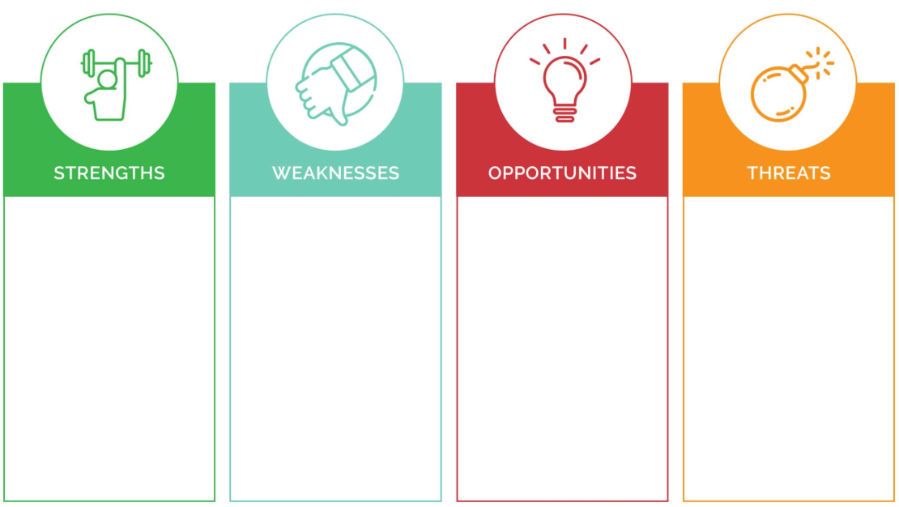
SWOT
• Industry Specialization
• Data-driven approach and Proven Track Record : success in institutions like Indiana University and Tufts University.
• Integrated Services: digital advertising, HubSpot onboarding, creative content…
• Experience : 40 years in the industry.
• Conversion-Centric Approach: aligned with client ROI goals.
• Dependency on nonprofits sector and institutions
• Limited Brand Awareness
• Scalability could restrain resources.
• revenue growth and human capital issues
• Competitive Pricing Pressure: Big competitors might undercut them on cost.
.
• Rising Demand for Affordable Digital Enrollment Solutions.
• Corporate Partnerships: Unlocking new revenue through sponsorships for nonprofits.
• Leverage AI & Automation
• Global Expansion: Seves international NGO Tech & Analytics: Enhances services and sharpens DD’s edge.
• Competitive market. Recessions may reduce charitable revenue.
• Economic Fluctuations
• Dependence on Key Clients.
• Regulatory Changes: Stricter data privacy laws (e.g., GDPR) could complicate donor outreach.

Slide 6
Competitor Analysis
Competitor | Focus | Performance Metrics & Capabilities | Objective & Value | Strategies | Weaknesses
Carnegie | Higher ed marketing & enrollment | 18%↓ cost-per-contact, 86%↑ website traffic, 23%↑ applications. Psychometric segmentation, Slate CRM optimization, brand strategy, student search, website development, and deep analytics. | Drive enrollment through human-centric, data-driven connections between institutions and students | Behavioral analytics, multi-channel campaigns, and institutional branding. | Niche focus limits diversification, high client dependency
Spark451 | Enrollment marketing & tech | 16%↑ graduate enrollments, 41%↓ cost-per-acquisition. Predictive modeling, Enrollytics data platform, social media/IP targeting, CRM integration, advanced analytics. | Deliver measurable enrollment growth via AI-driven insights and multi-channel campaigns | Data lake analytics, geo-targeted ads, and Gen Z-focused platforms (TikTok, Snapchat). | Over-reliance on tech vs. creative, limited brand strategy services
OHO Interactive | Digital marketing & web development | 2x organic traffic, 30%↑ lead quality. Full-funnel campaigns, CMS development, personalization engines, UTM tracking, user research, SEO, content marketing. | Recruit students via precision digital campaigns and website optimization | Paid search/SEM, retargeting, and content marketing. | Smaller team (vs. Carnegie), less focus on brand strategy

Slide 7
Competitor Analysis
Big Duck | Nonprofit branding & advocacy | 40%↑ web traffic, 4% site conversion rate, 30% lead-to-opportunity rate. Donor communications, advocacy campaigns, brand architecture, microsites, content marketing, and marketing automation. | Advance social missions through strategic storytelling and donor engagement | Content marketing, marketing automation, cohort trainings. | Limited higher ed specialization, narrower service scope
Mission Minded | Nonprofit branding & awareness | 25%↑ donor retention, 50%↑ brand reach. Impact storytelling, digital campaigns, audience research, narrative development, and multi-platform campaigns. | Amplify social good through bold, mission-driven branding | Narrative development, multi-platform campaigns. | Minimal higher ed focus, small team scale

Slide 8
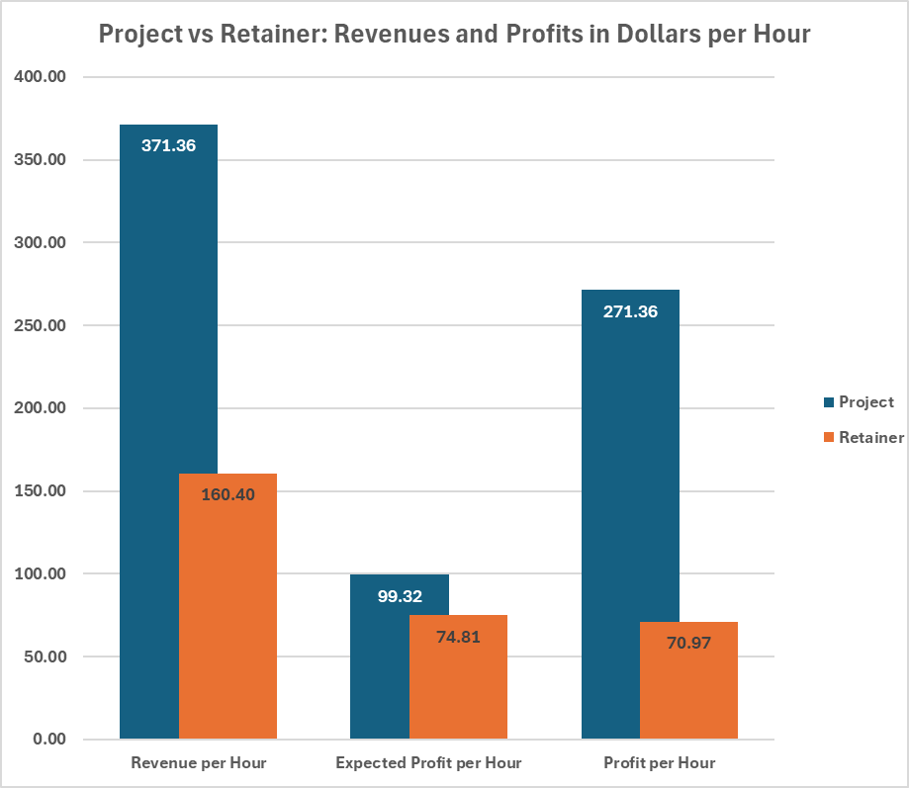
Projects lead Retainers on Profits
Projects, on average, provide 2.3 times the revenue per hour and 3.8 times the profit per hour despite estimates of only being marginally more profitable than retainers
Project revenue variance is far larger:
The std. dev. of Projects is $292.21
The std. dev. of Retainers is $82.77
There is a higher chance to lose money on Projects in a worst case scenario
Projects meet profit goals 93% of the time
How are these values distributed? What is really at risk?
Notes:
Tyler

Slide 9
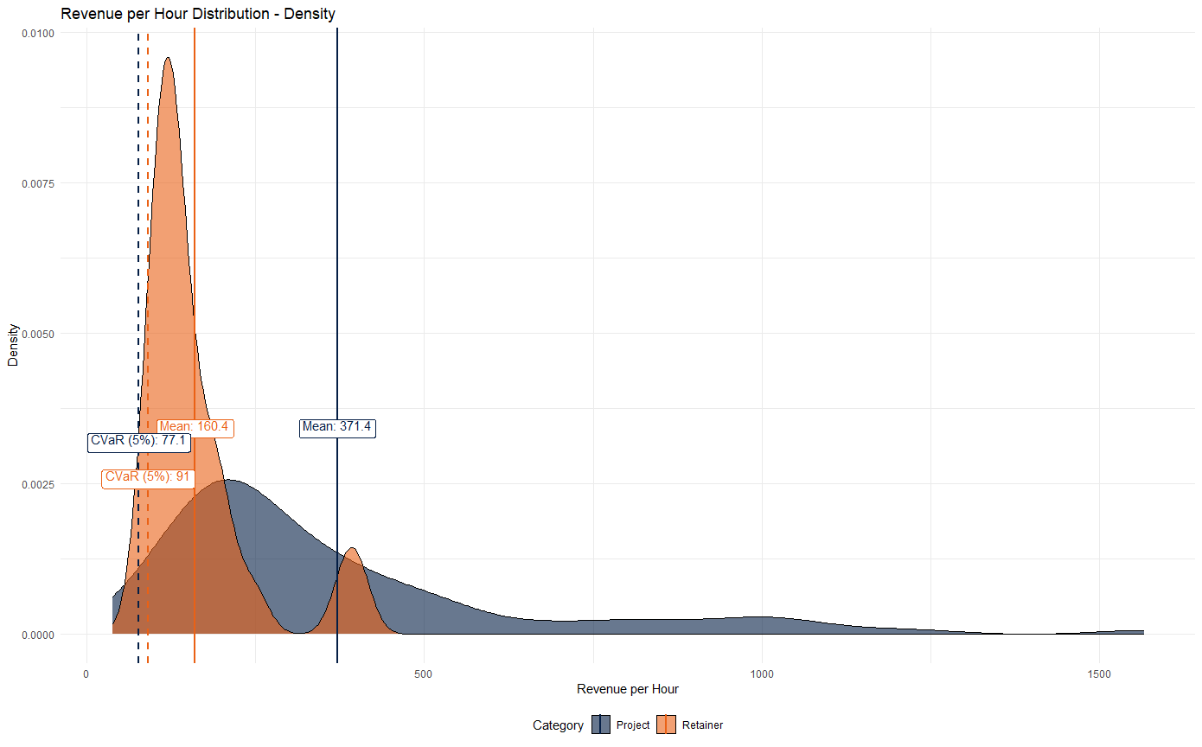
Individual Projects are Riskier than Retainers
Our data suggests that both Projects and Retainers have right-skewed, heavy tails
This is a good thing
The hourly revenue Conditional Values-at-Risk (CVaRs) vary:
Project CVaR: $77.10
Retainer CVaR: $91.00
Reinforces the fact that Retainers are a “safer” choice but projects have a better chance of high profits.
What’s the balance?
Notes:
Tyler

Slide 10
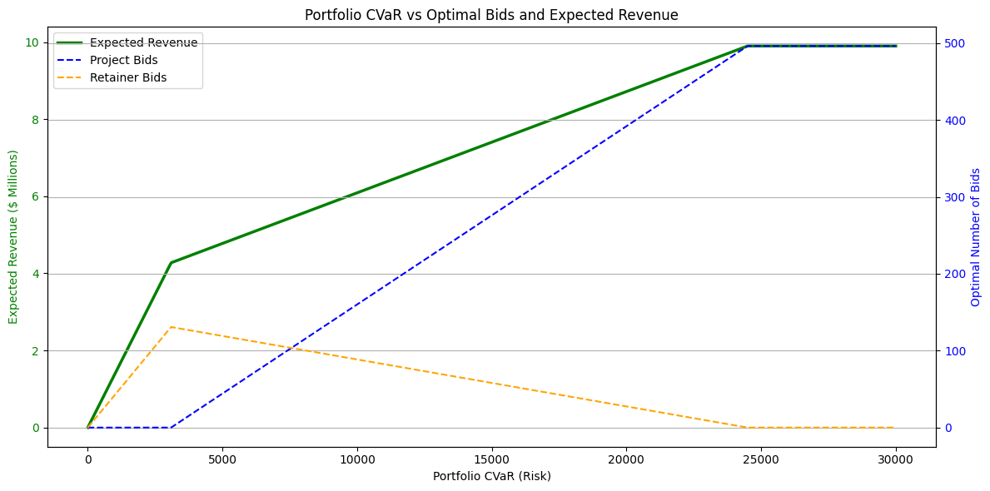
Optimizing Portfolios - Maximize Projects
To find our balance, we decide on acceptable risk
Using portfolio CVaR, w.e can calculate optimized portfolios.
At very low levels of risk, our model is dominated by retainers:
The green line represents expected revenue in millions.
The blue line represents the expected number of project bids.
The orange line represents the expected number of retainer bids.
Reaching 8M in Revenue at the Lowest Risk (CVaR: $17,300)
Project Bids: ~329 Annual Projects: ~211
Retainer Bids: ~44 Annual Retainers: ~11
Expected Revenue: 8.01M
Notes:
Tyler

Slide 11
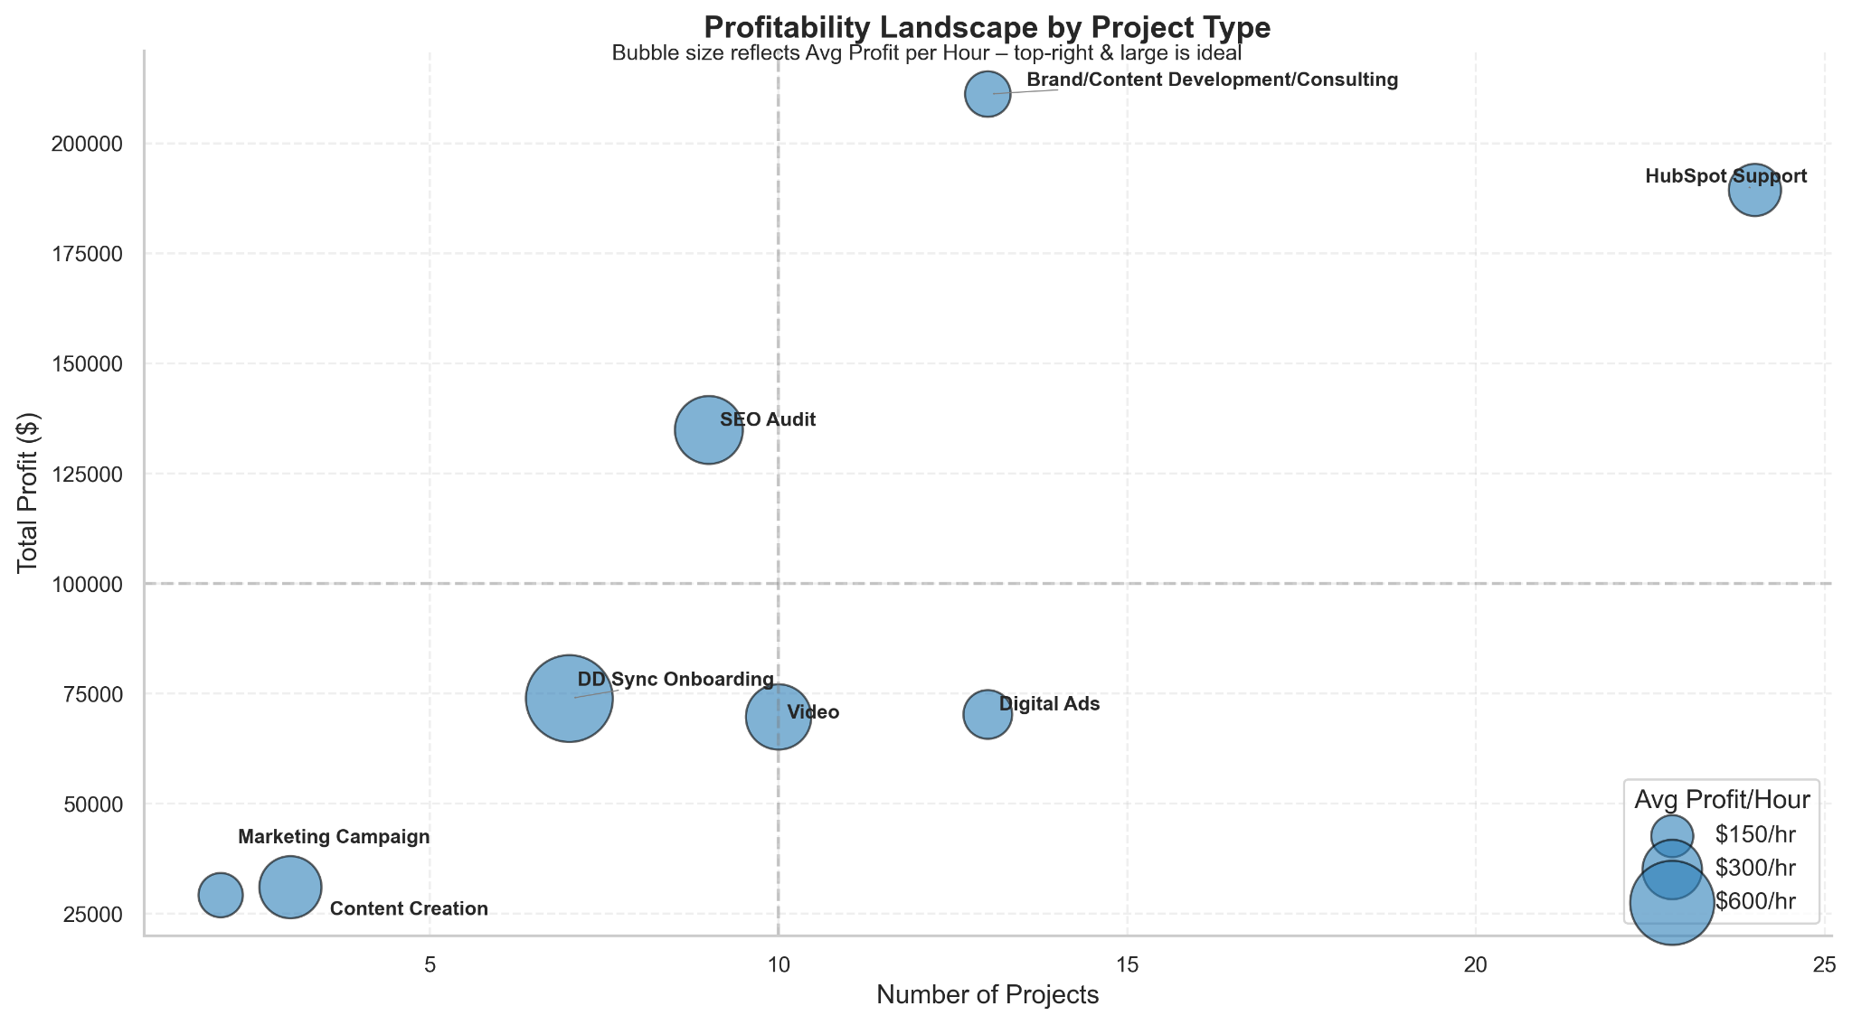
Profitability Landscape by Project Type
HubSpot Support and Brand/Content Consulting deliver the highest total profit, though with moderate efficiency.
DD Sync Onboarding and SEO Audit are the most efficient, generating the highest profit per hour.
Optimize profitability by increasing volume in efficient projects and improving efficiency in high-volume ones.
Notes:
Daniel
This chart compares project types based on volume, total profit, and efficiency (profit/hour as bubble size).
HubSpot Support and Brand/Content Consulting generate the most profit, driven by high volume, though their efficiency is moderate.
DD Sync Onboarding and SEO Audit are less frequent but highly efficient.
Recommendation: Consider scaling high-efficiency projects and improving margins in high-volume ones to enhance overall profitability.

Slide 12
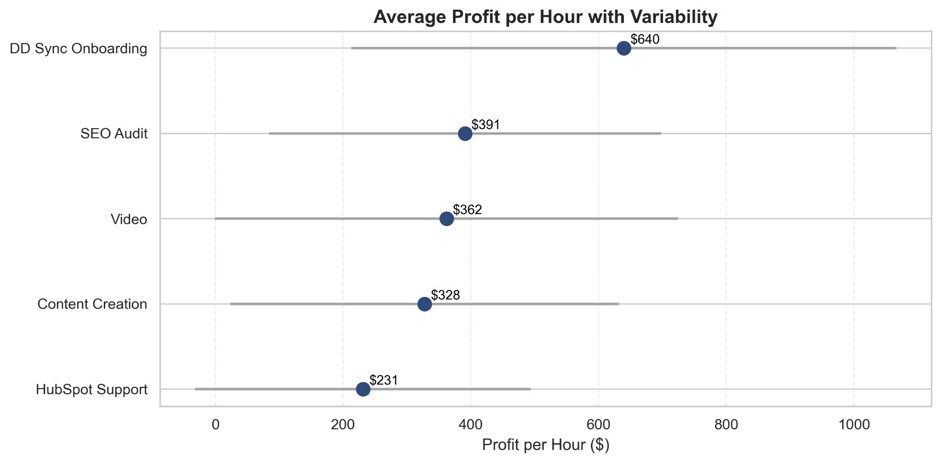
Efficiency Comparison
These are the top 5 most efficient project types, based on average profit per hour.
DD Sync Onboarding leads in efficiency, but with high variability, suggesting inconsistent performance across projects.
SEO Audit and Video offer both strong efficiency and lower variability, indicating more predictable profit returns.
Notes:
Daniel
This slide focuses on the top 5 project types by average profit/hour.
DD Sync Onboarding is the most efficient but has high variability.
SEO Audit and Video combine strong returns with consistency, making them strong candidates for scaling.
HubSpot Support ranks 5th overall in efficiency — still strong — but has room to improve consistency and margins.
Recommendation: Focus growth on efficient, consistent projects while refining delivery in high-volume categories.

Slide 13
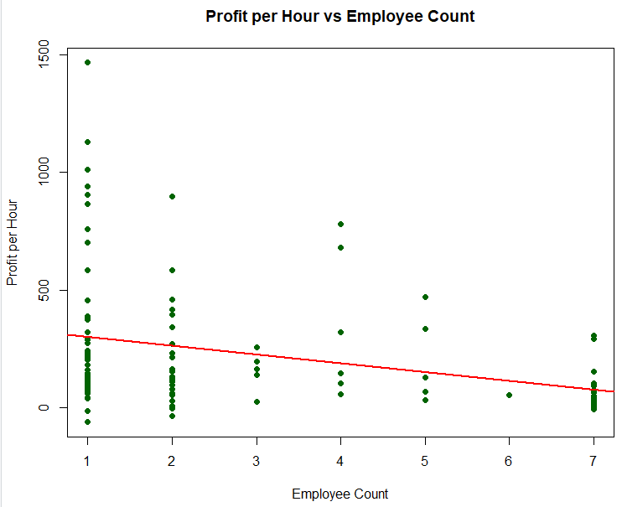
Employee Efficiency
We performed a linear regression on the existing projects and can be reasonably certain that there is a negative relationship between the number of employees on a project and the project’s profitability.
Each additional employee reduces profit by $37/hour on average
Projects with 1-2 employees (left side) deliver 2-3x higher margins than larger teams.
Smaller teams = higher profitability
Right-size teams—assign lean groups to high-value work like DD Sync Onboarding.
Notes:
Chipo - Your data reveals a clear efficiency pattern: smaller teams drive higher profitability.
Key finding: Each additional employee reduces profit by $37/hour on average.
Strategic implication: Projects with 1-2 employees deliver 2-3x higher margins than those of larger teams.
Action: Right-size teams for high-value work like DD Sync Onboarding to preserve margins.

Slide 14
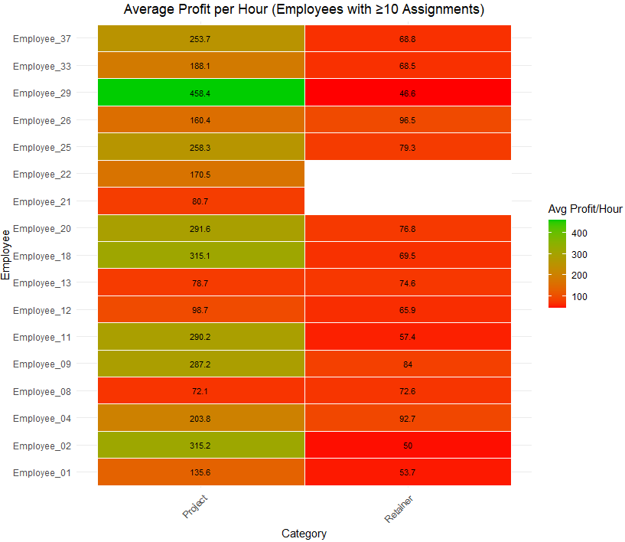
“Retainer Effect”
The lower overall profitability of Retainers may be affecting the perceived profitability per employee.
Employees working on projects deterministically outperform those on retainers
Even top performers show depressed profitability on retainer work. eg, E29 delivers 458/hr on projects but just 46/hr on retainers. E18 also drops fro 315/hr to 69/hr.
Lower urgency → Less focus on efficiency (Retainers)
Notes:
Chipo - However, a deeper analysis uncovers an unexpected constraint
Top performers (dark green) consistently deliver $300+/hour—some with fewer projects.
Even your top performers—like E29 and E18—show 80% lower profits on retainers versus projects.
Retainer work (right side) provides revenue stability but limit upside potential.
Takeaway: To reallocate star performers to strategic projects while streamlining retainers, e.g reallocate E29’s retainer hours to projects, there’s potential to gain $412/hour in profit.

Slide 15
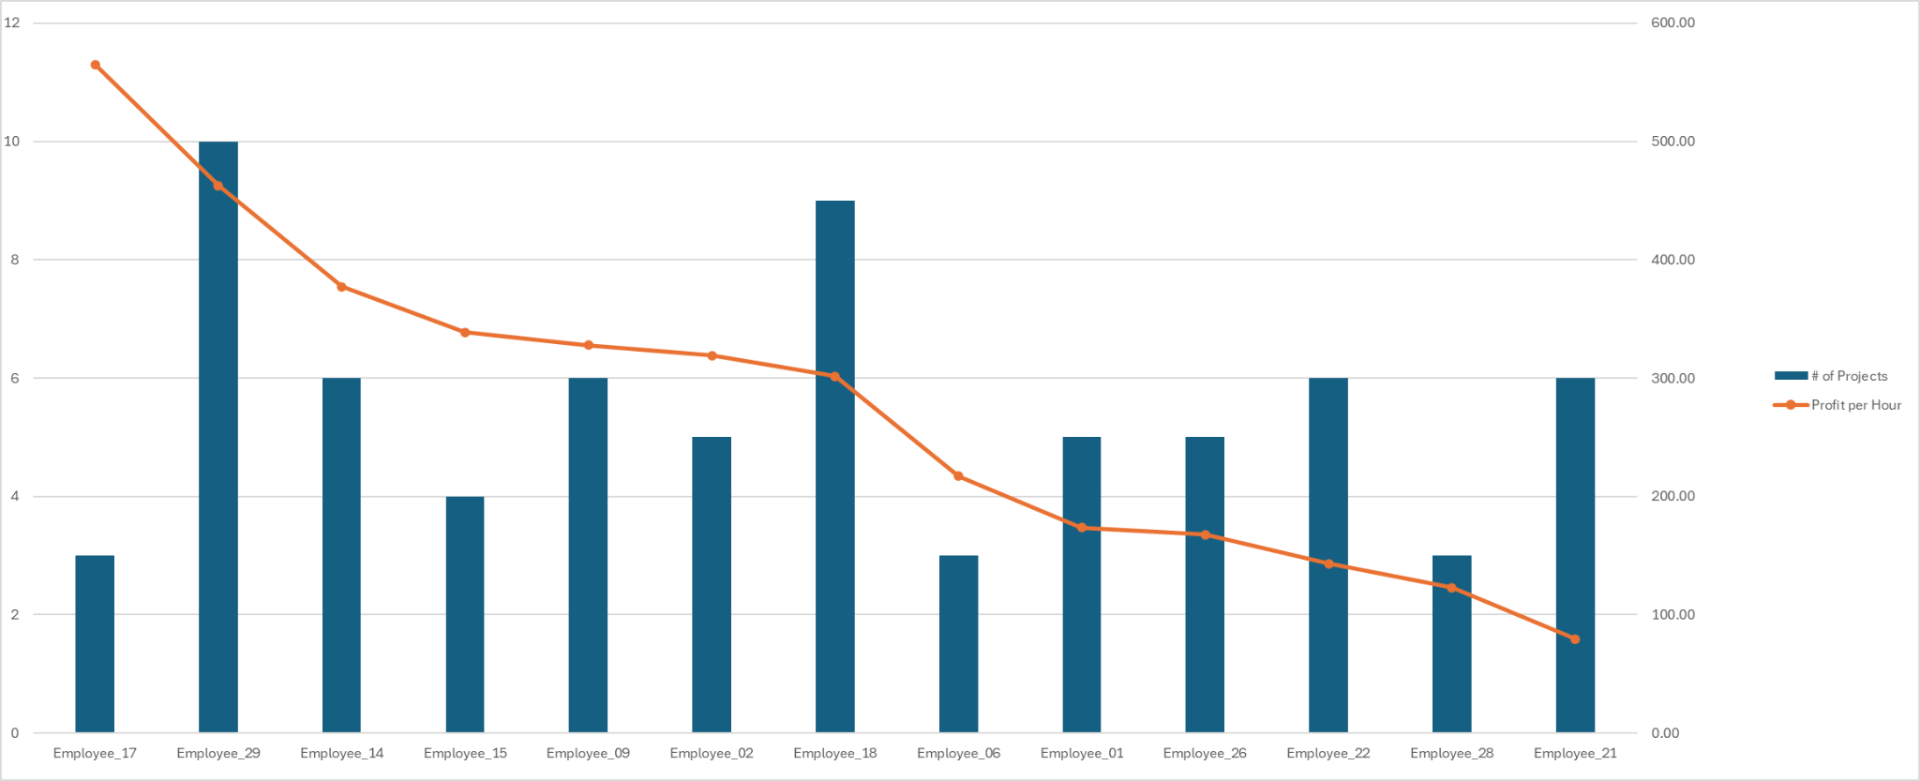
Individual Performance
Top 3 employees average $350+/hour
Some deliver high profit with few projects, others need support
Pair top performers with mid-tier staff to elevate overall efficiency
Notes:
Chipo - Three actionable insights emerge
Your best employees (E29, E18, E20) average $350+/hour—a target for talent strategy.
Variability: Some deliver high profit with few projects (E29), while others need support (E21 at $81/hour).
Recommendation: Pair top performers with mid-tier staff to elevate overall efficiency.
Reallocating just two employees from retainers to projects could yield an 81% profit gain per hour.

Slide 16
Recommendations
Over the next three years:
Phase in a business development pipeline that will identify enough Project opportunities.
Goal is to have ~211 active Projects and ~11 Retainers annually if no other changes are made.
Utilize the team resources on smaller assignments that require fewer employees.
Provide more opportunities for top performers to take on work, or have them work with those that struggle more to learn their techniques.
Target SEO Audits, HubSpot Support, and Brand Consulting for profitability and volume.
Improve efficiency in Video and Digital Ads by tightening scope and optimizing delivery to reduce variability and increase margins.

Slide 17
Q&A & Closing
Questions, Concerns, Uncertainties?

Slide 18
Thank You

